Slide 1

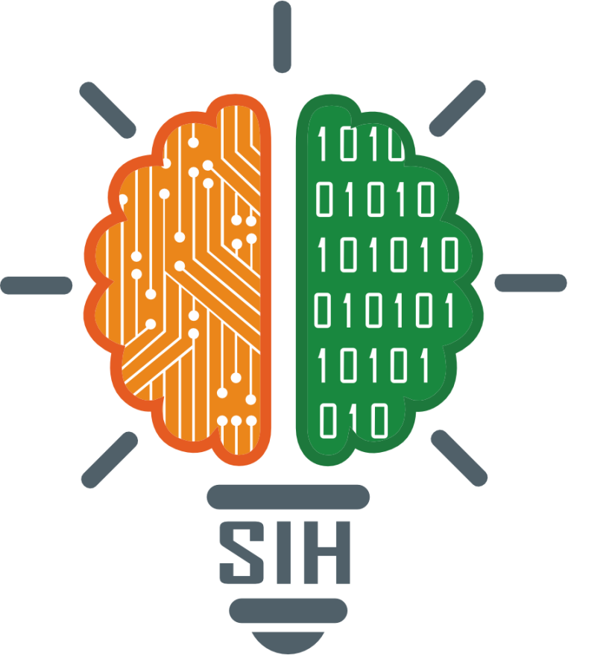
SMART INDIA HACKATHON 2024
TITLE PAGE
Problem Statement ID – 1638
Problem Statement Title - AI-Driven Crop Disease Prediction and Management System
Theme - Agriculture, FoodTech & Rural Development
PS Category- Software
Team ID -
Team Name - Sonic Coders

Slide 2
IDEA TITLE
Sonic Coders
Proposed Solution:
Develop a mobile and web-based AI system that predicts crop diseases from images and environmental data.
The system offers disease identification, treatment recommendations, and preventive measures.
Focus on crops like grapes, coconut, sugarcane, tomato, and potato using a custom CNN model.
How it addresses the problem:
Early detection minimizes crop loss, boosts productivity, and reduces financial burden on farmers.
Provides actionable insights and reduces dependency on manual disease identification.
Innovation:
High-accuracy disease detection (98%+) using deep learning.
Real-time prediction and advice, integrated with environmental data for accurate results.

Slide 3
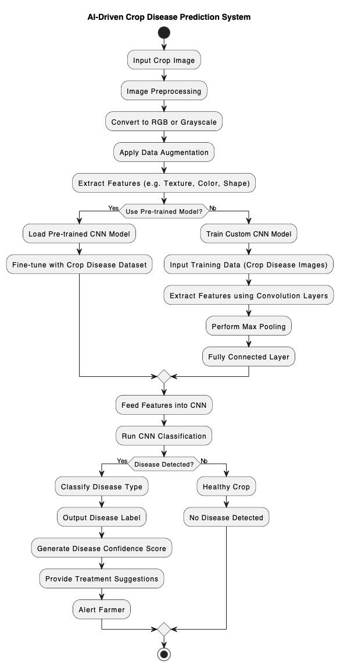
TECHNICAL APPROACH
Sonic Coders
Technologies:
Python, TensorFlow, Jupyter Notebook for AI and ML model development.
Mobile and web development frameworks: Flutter, React Native.
Cloud storage for environmental and image data: AWS/GCP.
Methodology:
Data Collection: Gathering leaf disease images and environmental data.
Model Development: Training custom CNN models for each crop.
Deployment: Deploying the model as an API for real-time analysis in a mobile/web app.

Slide 4
TECHNICAL APPROACH
Sonic Coders
Prototype Workflow:

Slide 5
FEASIBILITY AND VIABILITY
Sonic Coders
Feasibility:
CNN models have achieved 98%+ accuracy for different crops.
Scalable architecture for both mobile and web platforms.
Challenges:
Variability in image quality from different devices.
Incorporating environmental data like humidity and temperature.
Network connectivity in rural areas.
Strategies:
Use image preprocessing techniques to handle variability.
Use IoT devices to gather real-time environmental data.
Optimize model size for mobile deployment to work offline.

Slide 6
IMPACT AND BENEFITS
Sonic Coders
Target Audience:
Farmers, agricultural researchers, and policymakers.
Benefits:
Social: Empowers farmers with modern technology for disease prevention.
Economic: Reduces crop loss, increasing farmers’ income.
Environmental: Reduces pesticide overuse through precise recommendations, improving sustainability.

Slide 7
RESEARCH AND REFERENCES
Sonic Coders
Research Sources:
Research papers on crop disease detection using CNN models.
Agricultural disease databases.
TensorFlow and AI model training references.
Links: (Few Important Links)
Mohanty Sharada P. , Hughes David P. , Salathé Marcel,Using Deep Learning for Image-Based Plant Disease Detection, https://www.frontiersin.org/journals/plant-science/articles/10.3389/fpls.2016.01419
Md. Manowarul Islam, Md Abdul Ahad Adil, Md. Alamin Talukder, Md. Khabir Uddin Ahamed, Md Ashraf Uddin, Md. Kamran Hasan, Selina Sharmin, Md. Mahbubur Rahman, Sumon Kumar Debnath, DeepCrop: Deep learning-based crop disease prediction with web application, https://www.sciencedirect.com/science/article/pii/S2666154323002715
Zubair Saeed, Ali Raza, Ans H. Qureshi, Muhammad Haroon Yousaf, A Multi-Crop Disease Detection and Classification Approach using CNN, https://www.researchgate.net/publication/357390851_A_Multi-Crop_Disease_Detection_and_Classification_Approach_using_CNN

